Slide 1
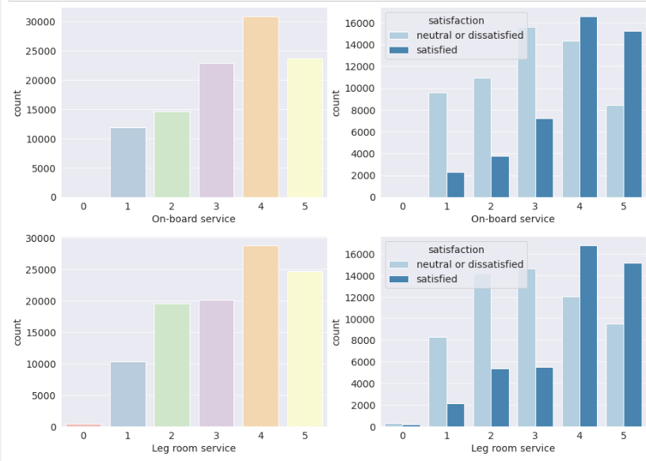
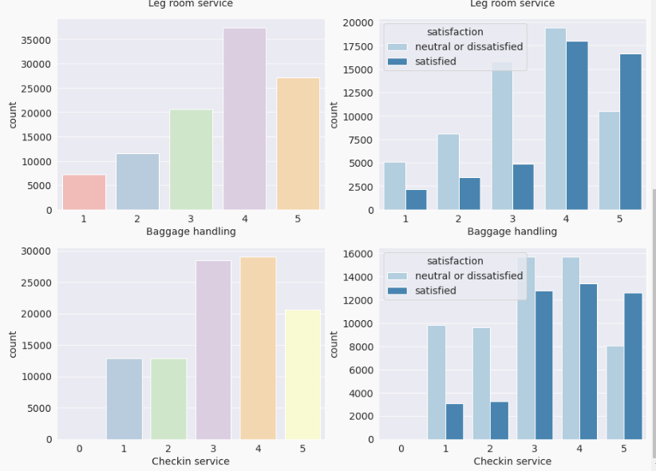
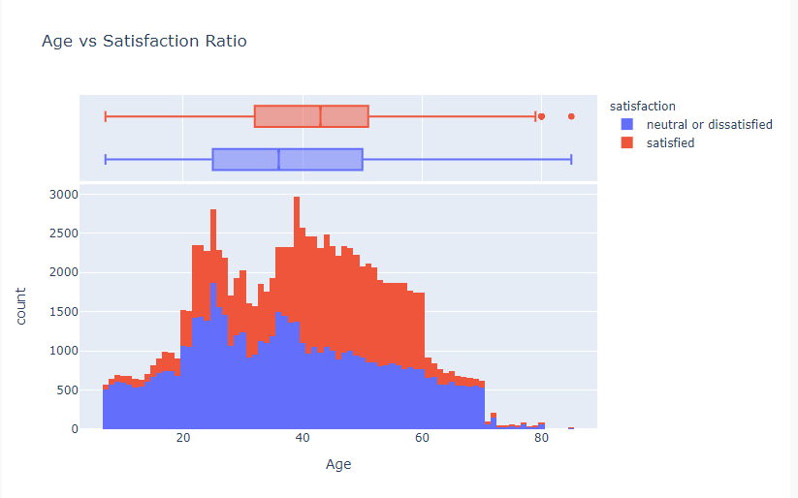



Airline satisfaction
Arav Sharma
Background
Results
Problem Statement: can we use Machine Learning to predict whether the passengers are satisfied with the services of an airline based on certain factors.
About the Dataset: Consists of 2 csv files; train.csv and test.csv. It contains 23 different attributes such as gender, age, customer type, etc. These factors/attributes determine customer satisfaction as they provide information on their rating of different services of the flight.
Discuss and analyze the research results, including:
Based on Figure 1&2, inflight wifi service seemed to be most important in determining customer satisfaction because all passengers that had given 5/5 to this service were satisfied with the overall service(about 12500)- a trend not observed with other factors like ease of online booking).
Figure 3 shows that most of the data is distributed normally and has very few outliers. Histogram depicts that as age increases customer satisfaction also increases (and vice-versa). For example, in the dataset, there are 1520 passengers who are 20, out of which 1057 were dissatisfied/neutral and 463 were satisfied. Similarly, at age 60, 974 were satisfied whereas 769 were dissatisfied/neutral.
Decision Tree classifier was a better model than KNN as it had a higher accuracy (92.6971% vs 92.1658%).
Figure 1&2. Bar graph depicting answer to question 1.
Research Questions
Conclusions
- What is the customer satisfaction variation with respect to customer input (inflight service, departure arrival time, ease of online booking, gate location)?
-Does age impact customer satisfaction?
-Which algorithm (DecisionTreeClassifier or KNN) is the most accurate in predicting customer satisfaction?
Conclusion/discussion:
Using figure 3, due to its unpopularity with younger age groups, the airlines could increase the marketing of its services towards them more/include features to their airplanes that resonate with younger audiences.
In conclusion, majority of the passengers are dissatisfied with the airline services- another reason for the airline to upgrade their services and values.
Future work:
Based on the current findings, a UI using SteamLit, could be created which the Airline could use to keep track of the popularity of it’s service (based on Customer Satisfaction).
Methods
Created a function that displays correlation between services such as wifi and customer satisfaction by a bar chart.
Similar to the above method, through a histogram, I plotted the age of the passengers on the x-axis.
Limitations of the overall research project include that the dataset had a separate neural and unsatisfied category. There should instead be 3 different groups; satisfied, unsatisfied, neural. This would provide more meaningful predictions as it’s hard to divide between neutral and unsatisfied passengers.
Figure 3. Histogram depicting customer satisfaction and age.
Acknowledgments
I would like to thank the faculty @ Ai4all for their immense dedication in making me understand ML concepts like Supervised and Unsupervised ML. The mini-project was extremely fun and allowed me to apply my knowledge.
Figure 4. Accuracies of different machine learning models in predicting customer satisfaction.
AI4ALL@Paul G. Allen School

